Slide 1

Group - 6
Presenting
On
Fraud Detection - Warranty Claim
Group Members
Sharath P
Dharma Raja B L
Mentor Name : Neha

Slide 2

Business Problem:
To detect fraudulent/Genuine warranty Claim/Complain requested by Customer
Objective:
The objective of the analysis is to predict an appliances TV& AC sold, what is the probability that customer would file fraudulent/Genuine warranty and to understand important factors associated with them.

Slide 3
Project Architecture / Project Flow
Understand the Problem
Data Processing & EDA
Model Development
Model Deployment
Model Validation

Slide 4
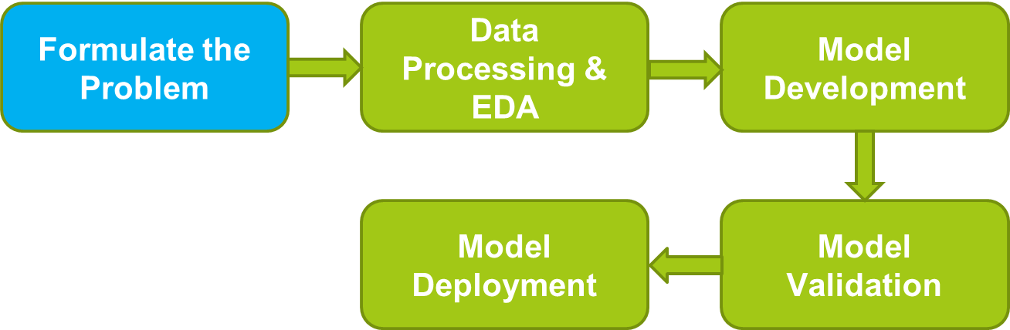
Objective:
The objective of the analysis is to predict an appliances TV& AC sold, what is the probability that customer would file fraudulent/Genuine warranty and to understand important factors associated with them.

Slide 5
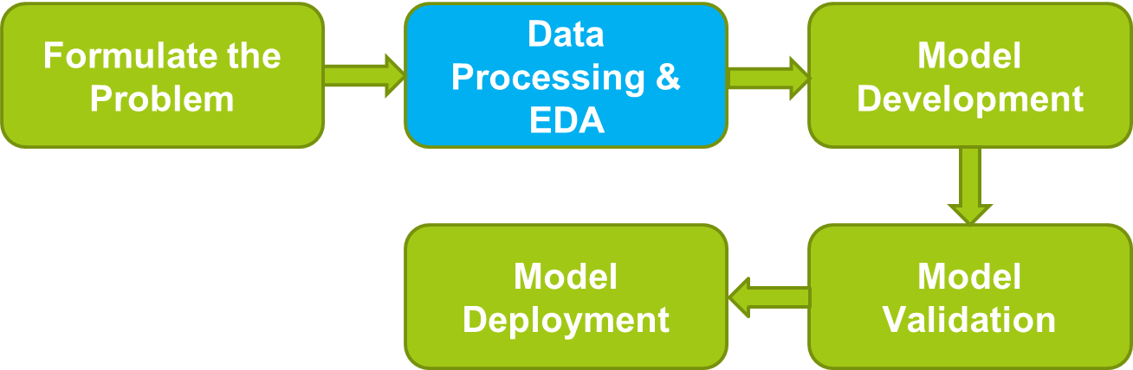
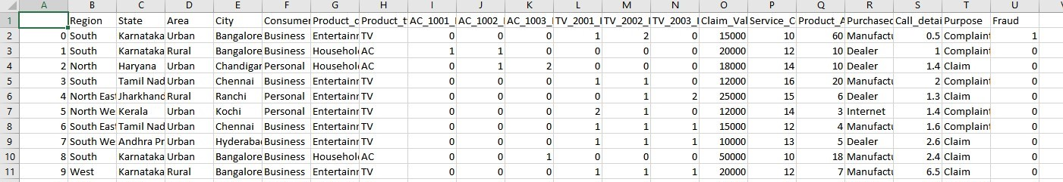
Data Processing & Exploratory
Data Analysis (EDA)
Total Records : 358
Features : 20
Missing values : None

Slide 6
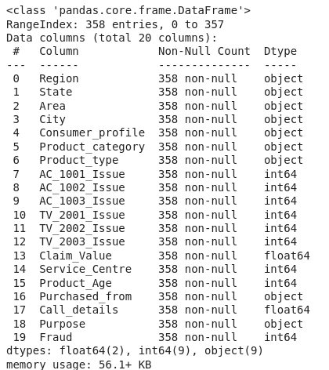
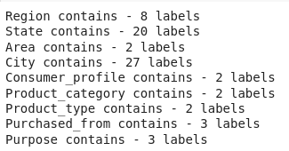
Preliminary EDA
Total Records : 358
Features : 20
No Missing values observed in given dataset
Identified unique values

Slide 7
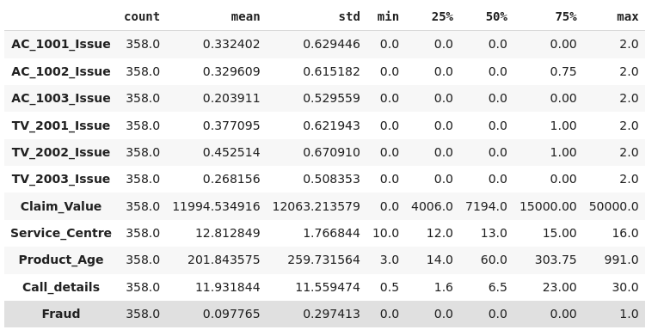
Following image shows mean, std, min-max and upper lower quartile range.

Slide 8
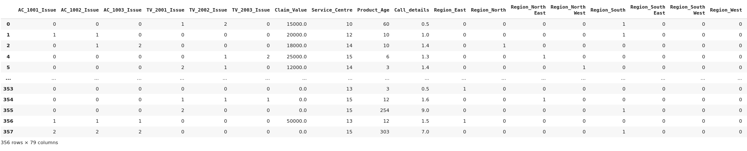
Dummy Encoding
Creating a dummy variable for each columns.

Slide 9
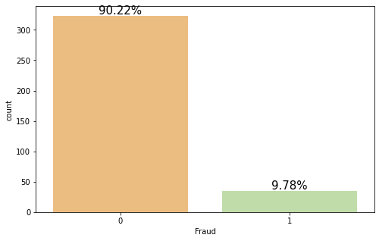
Imbalanced Data & Resampling Techniques
Resampling techniques
Oversampling
Undersampling
Ensemble Methods

Slide 10
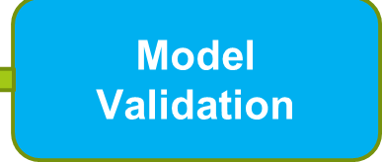
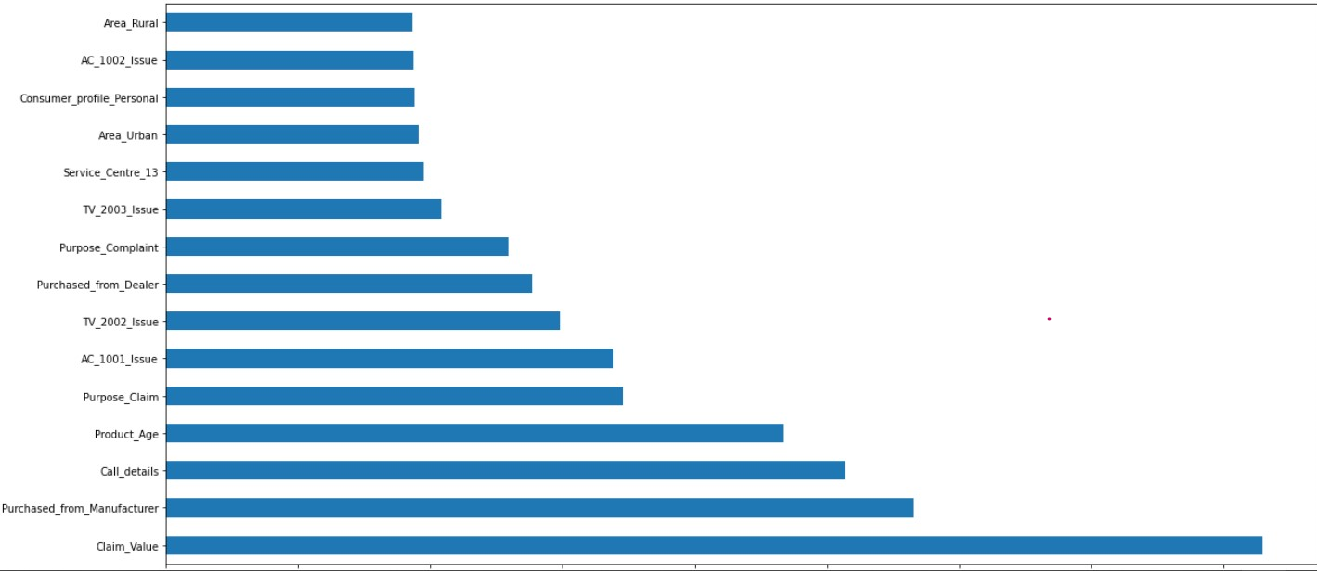
Feature Importance, Resampling & CV
Balancing the data Before Modeling.
Resampling - SMOTE(Synthetic Minority Over Sampling Technique)
Cross Validation – K fold

Slide 11
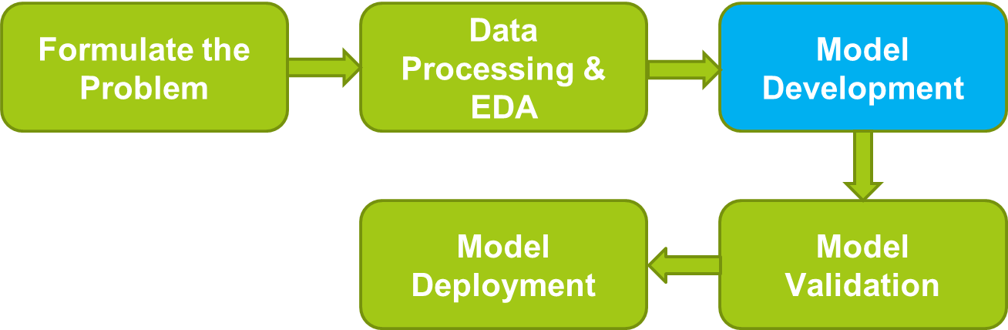
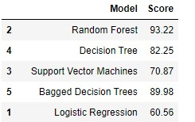
Applying different models

Slide 12
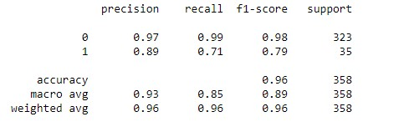
Models Selection
Random Forest accuracy is 93.22.
Here, is the classification report.

Slide 13
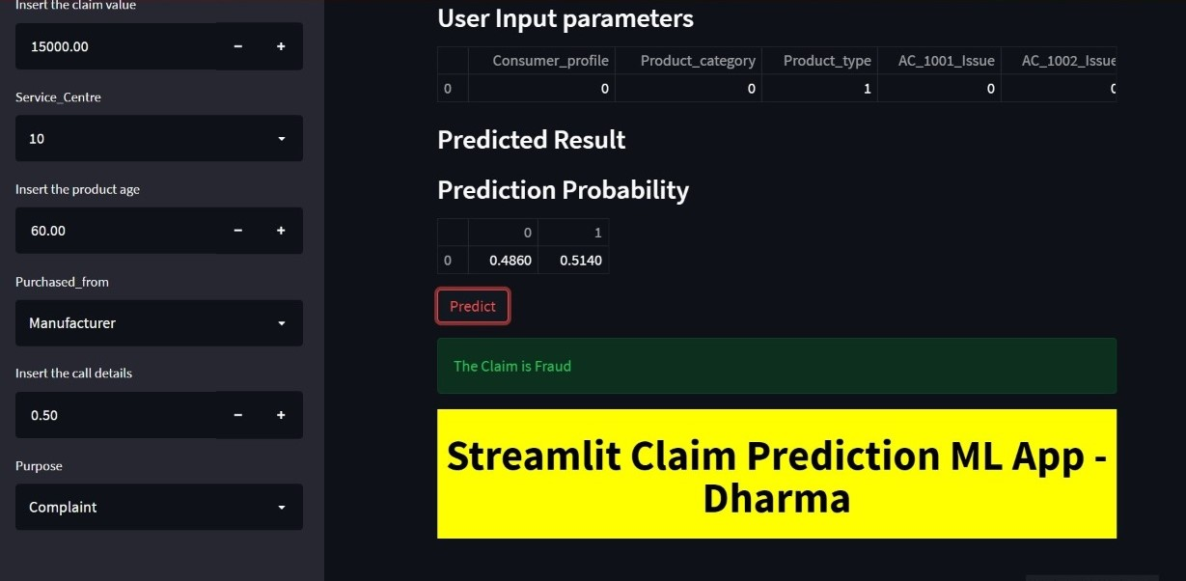
Model Deployment
Formulate the Problem
Data Processing & EDA
Model Development
Model Deployment
Model Validation

Slide 14
Challenges
How did you Overcome?
The imbalanced data handled with resampling technique –SMOTE
As we are having very less records we didn’t gone for train and test split method instead we have used K fold
Categorical columns having more unique values handled with encoding and by using features importance we have eliminated the less important features
The data is imbalanced
The given data is very less
Categorical columns having more unique values

Slide 15
THANK YOU!

